Slide 1
Introduction to GIS
Matt Quick
December 7, 2015

Slide 2
What does GIS do?
1) Provides a database framework to integrate spatial and non-spatial data

Slide 3
What does GIS do?
1) Provides a database framework to integrate spatial and non-spatial data
2) Mapping and visualization

Slide 4
What does GIS do?
1) Provides a database framework to integrate spatial and non-spatial data
2) Mapping and visualization
3) Analysis

Slide 5
GIS Software
ArcGIS
• Most popular
• Online and desktop versions
• Probably use this in professional
contexts
Quantum GIS
• Free and open source
• Robust user community

Slide 6
Map Projections
Earth is an oblate spheriod.
Computer screens and maps are flat.
Map projections represent spheriods on flat surface. However, often a trade-off between distance, direction, scale, and area.

Slide 7
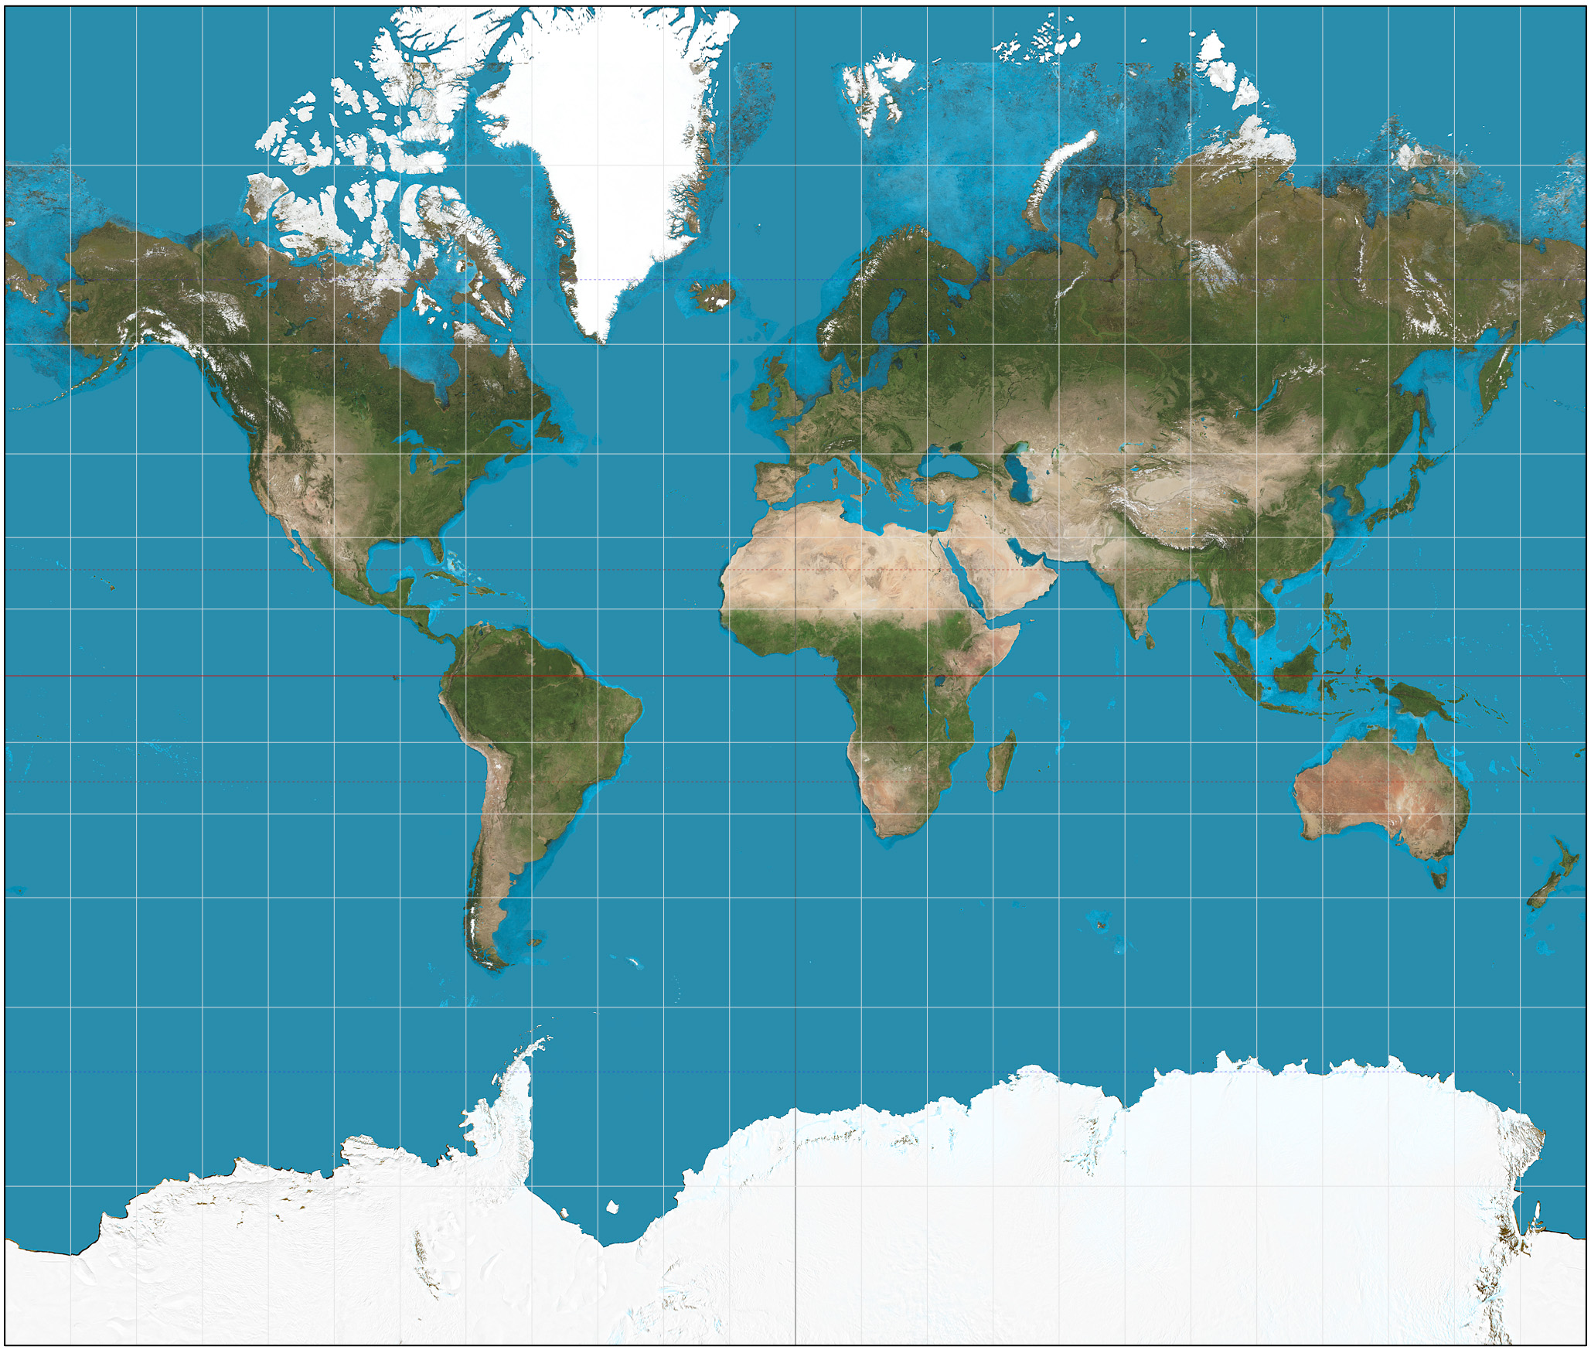

Slide 8
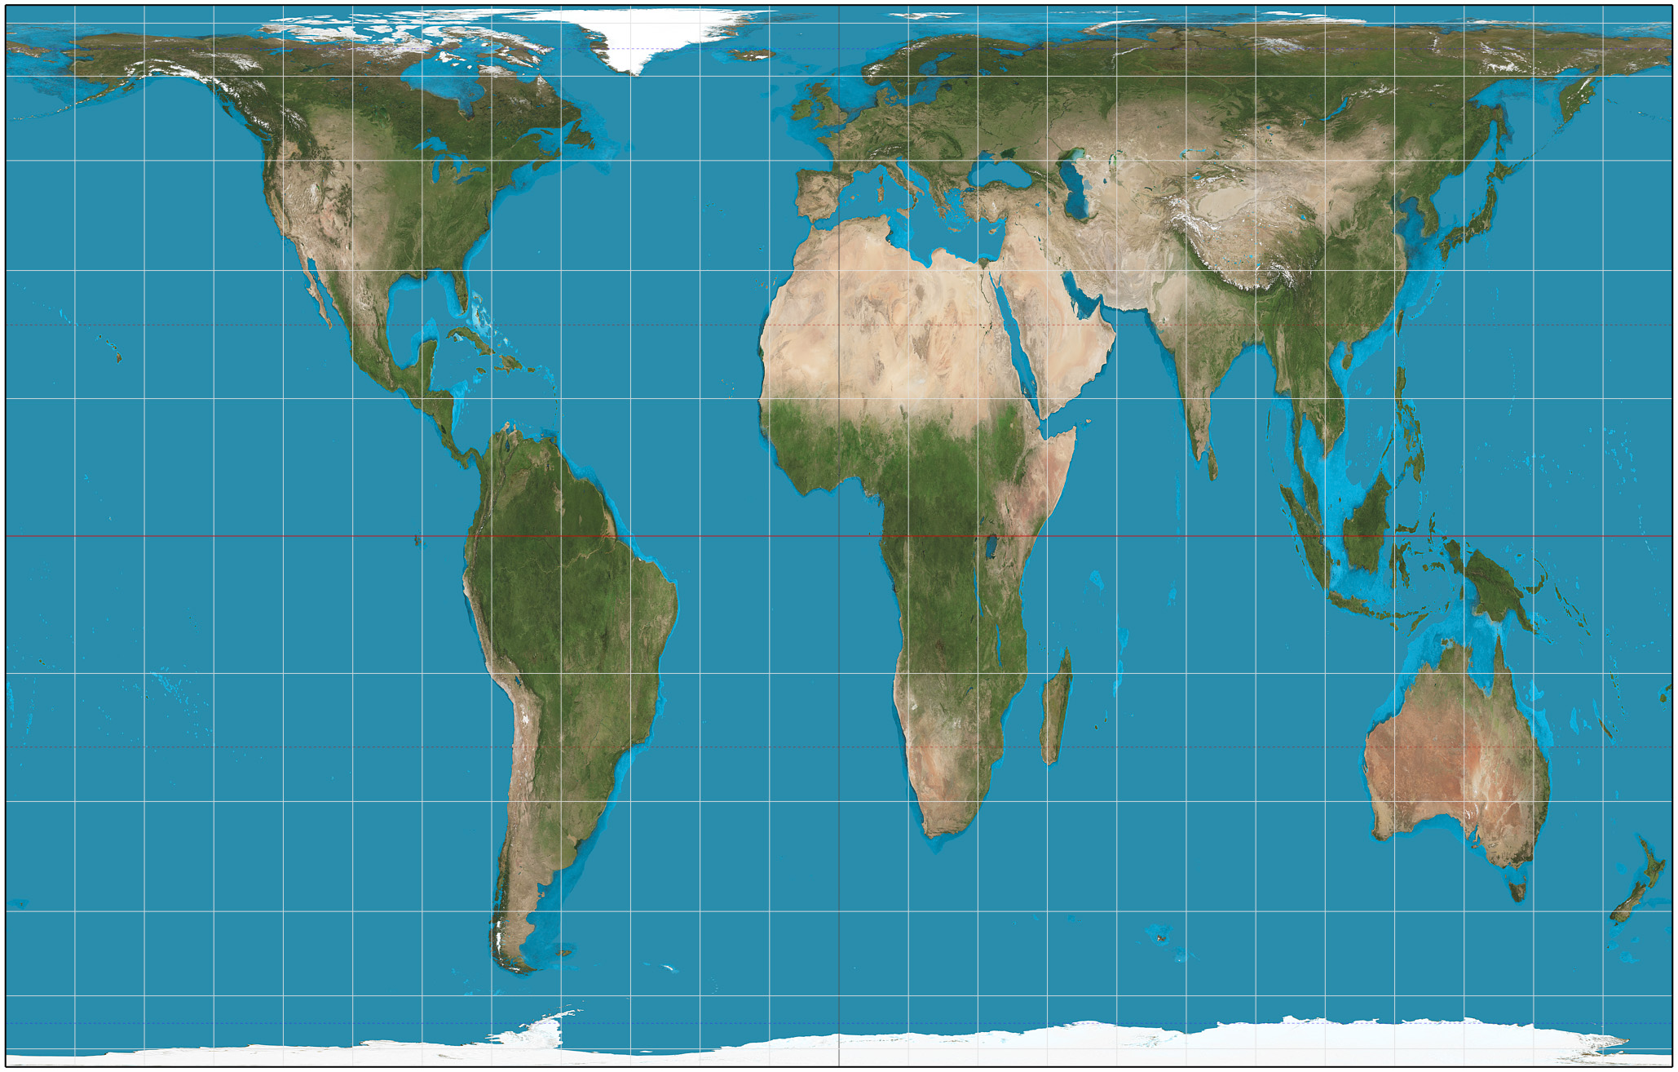
Notes:
http://spatialreference.org/

Slide 9
Spatial Data Types
Raster
• Grid cells (rows, columns)
• Each cell contains data
Example: Satellite image of Kitchener, each cell contains colour / temperature / elevation

Slide 10
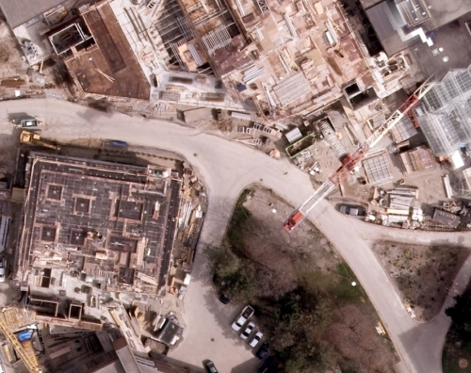

Slide 11
Spatial Data Types
Vector
• Coordinate-based (x,y)
• Points, lines, polygons
• Each point / line / polygon contains data
Example: Hospital with number of beds / doctors.

Slide 12
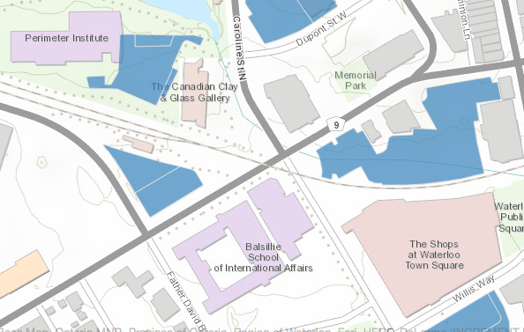

Slide 13
File types
Today, we’ll be dealing with shapefiles (.shp) and comma-separated values (.csv).
Shapefiles store geographic data.
Comma-separated value files stores tabular data.

Slide 15
GIS: Getting Started
Create a folder (\Desktop)
This is where we will store our files today.

Slide 16
Waterloo Region Census Tracts
Download Census Tract shapefile at:
https://github.com/matthewquick/introGIS/tree/master/_data
Also being passed around on USB key

Slide 17
Waterloo Region Census Tracts
Add shapefile to ArcGIS:
File > Add data > …
Examine properties:
Right-click shapefile > Properties
Examine attribute table:
Right-click shapefile > Attribute Table

Slide 18
Income Data
Canadian Census Analyzer:
UWaterloo Library > Find & Use Resources > Statistics & Numerical Data > Canadian Census Analyzer

Slide 19
Income Data
We want 2006 Median Income for Census Tracts in Waterloo Region.
Census Tract > 2006 (Cumulative) > Income and Earnings > Kitchener > Median Income ($)
Include CTUID > Download to a file > CSV > Submit Query

Slide 20
Income Data
Download _data.csv and _header.txt to (/Desktop/...)
Open in Excel and rename columns according to _header.txt
Delete CTUID = 0 (this is average for CMA)
We need to alter CTUID to have 2 decimal places:
Right-click column > Format Cells > Number > 2 decimals

Slide 21
Income Data
Add to GIS:
File > Add Data > ...
Investigate income data:
Right-click .csv > Attribute Table
What column is shared between income data and shapefile?

Slide 22
Joining Data
We need to join the shapefile and income so we can map income.
Right-click shapefile > Properties > Join
Join based on CTUID > Check Join

Slide 23
Joining Data
Check that the join worked:
Right-click shapefile > Attribute Table
Is median income there?

Slide 24
Mapping Median Income
Now we want to map median income:
Right-click shapefile > Properties > Symbology
Select Attribute to Map (Median Income)
Select breakpoints
Select colour scheme

Slide 25
Get Data: Transit Routes
Waterloo Region Open Data:
http://www.regionofwaterloo.ca/en/regionalgovernment/OpenDataHome.asp
Download data:
Transit – GRT Routes > .shp

Slide 26
Transit Route Data
Add transit data to GIS
Open properties and check projection
Open attribute table

Slide 27
Interactive Map Data - Table
Map Data -> Table
Select tool > click on route (on map)> Open attribute table
Table -> Map Data
Click row in attribute table > view map data

Slide 28
Creating a map
Layout View is used to create final map products.
Supplement data with north arrows, legends, scales.
Add text, lines, description, etc.

Slide 29
Creating a map
Bottom left corner > Layout View
Add North Arrow
Add Legend
Add Scalebar
To edit data (colour scheme) go back to Data View

